Slide 1

TRIP TO .NET MAUI

Slide 2



About me
Digital Product Manager – FME Italy
Former Microsoft MVP – Developer Technologies
Coach - https://codingcoach.io/ Mentor
@_Codrina_

Slide 3
.NET -Your platform for building anything
Notes:
Iniziamo da . NET
.NET is a free, cross-platform, open source developer platform for building many different types of applications.
With .NET, you can use multiple languages, editors, and libraries to build for web, mobile, desktop, games, IoT, and more.

Slide 4

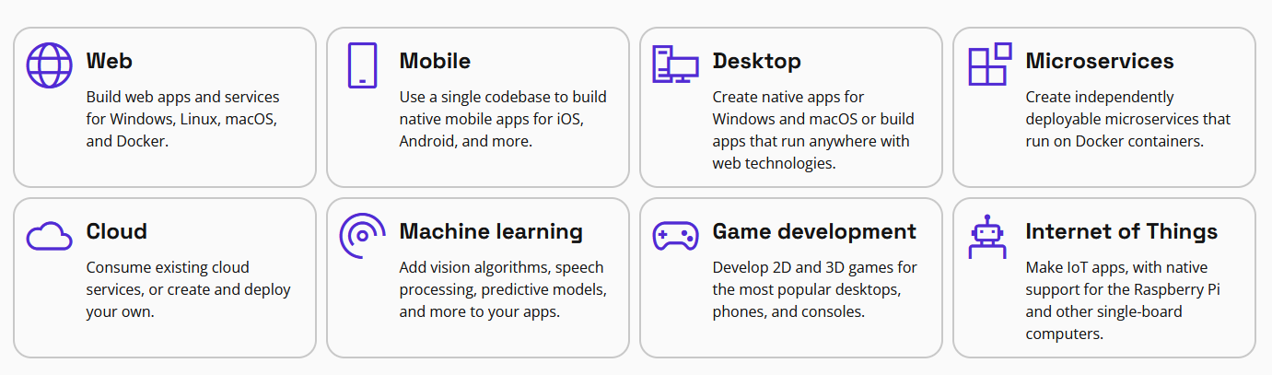
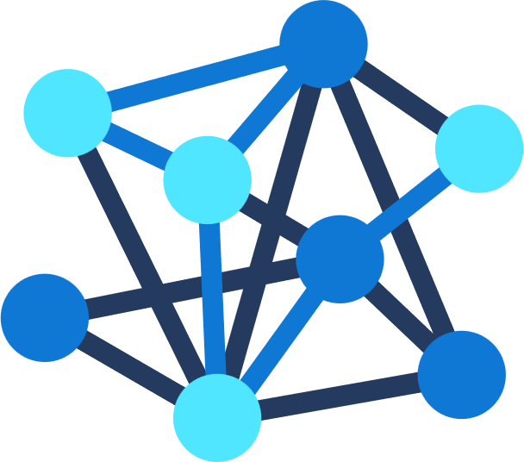

.NET
Your platform for building anything
Desktop
Web
Cloud
Mobile
Gaming
IoT
AI
Notes:
.NET is a free, cross-platform, open source developer platform for building many different types of applications.
With .NET, you can use multiple languages, editors, and libraries to build for web, mobile, desktop, games, IoT, and more.
You can write .NET apps in C#, F#, or Visual Basic.
C# is a simple, modern, object-oriented, and type-safe programming language.
F# is a programming language that makes it easy to write succinct, robust, and performant code.
Visual Basic is an approachable language with a simple syntax for building type-safe, object-oriented apps.
NET provides a standard set of base class libraries and APIs that are common to all .NET applications.
Each app model can also expose additional APIs that are specific to the operating systems it runs on, or the capabilities it provides. For example, ASP.NET is the cross-platform web framework that provides additional APIs for building web apps that run on Linux or Windows.

Slide 5


ONCE UPON A TIME…
2014 – Xamarin v3 with introduction of Xamarin.Forms and a unified product
2001 – .NET on Linux and mono project creation
April 2020 –.NET MAUI is announced at Microsoft Build
Dicember 2023 –.NET MAUI with .NET 8
2010 – Xamarin startup is created
February 2016 –Xamarin acquired by Microsoft
May 2022 –.NET MAUI is available
Notes:
Sponsored by Microsoft, Mono is an open source implementation of Microsoft's .NET Framework based on the ECMA standards for C# and the Common Language Runtime. A growing family of solutions and an active and enthusiastic contributing community is helping position Mono to become the leading choice for development of cross platform applications.

Slide 6
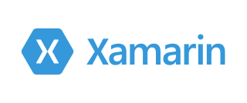
Xamarin
Free. Cross-platform. Open source.
An app platform for building
Android and iOS app with .NET and C#
Notes:
Xamarin extends .NET
Xamarin extends the .NET platform with tools and libraries specifically for building apps on iOS, Android, macOS, and more.
These are some things that Xamarin adds to the .NET platform:
Base framework for accessing native features
Extensible Markup Language, known as XAML, for building dynamic mobile apps using C#
Libraries for common patterns, such as Model View ViewModel(MVVM)
Platform specific libraries that includes access to APIs from Google, Apple, Facebook, and more to add rich capabilities
Editor extensions to provide syntax highlighting, code completion, designers, and other functionality specifically for developing mobile pages

Slide 7
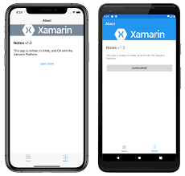
Xamarin.Forms
An open-source framework
for building iOS, Android, and Windows apps
Notes:
Xamarin.Forms is an open source cross-platform framework from Microsoft for building iOS, Android, & Windows apps with .NET from a single shared codebase.
Use Xamarin.Forms built in pages, layouts, and controls to build and design mobile apps from a single API that is highly extensible. Subclass any control to customize their behavior or define your own controls, layouts, pages, and cells to make your app pixel perfect.

Slide 8


Notes:
L'isola di Maui è la seconda, per superficie (1883 km²), delle isole hawaiiane. È la sede della contea di Maui, che comprende anche Molokai, Lanai, Kahoolawe e l'isolotto di Molokini. L'isola di Maui ha una popolazione di 168.307 abitanti (2020).
Geograficamente, l'isola consiste di due grandi vulcani, uno a ovest (le montagne di Maui occidentale, che arrivano fino al Pu'u Kukui) e l'Haleakalā a est, il più grande (e attivo molto più di recente). Fra i due grandi vulcani si trova un notevole e fertile istmo, con i paesi di Kahului (e l'aeroporto principale) e Wailuku a nord, e Maalaea e Kihei a sud. Altri paesi importanti sono Lahaina a ovest (un tempo capitale del regno delle Hawaii) e Hana a est. Altri paesi di interesse turistico sono Wailea, a sud di Kihei, Pa'ia, a nord-est di Kahului, e la valle di I'ao, a sud di Wailuku.

Slide 9

.NET Multi-platform App UI (MAUI)
Single project system, single codebase
macOS
iOS
WinUI
Mac Catalyst
iOS
Android

Slide 10
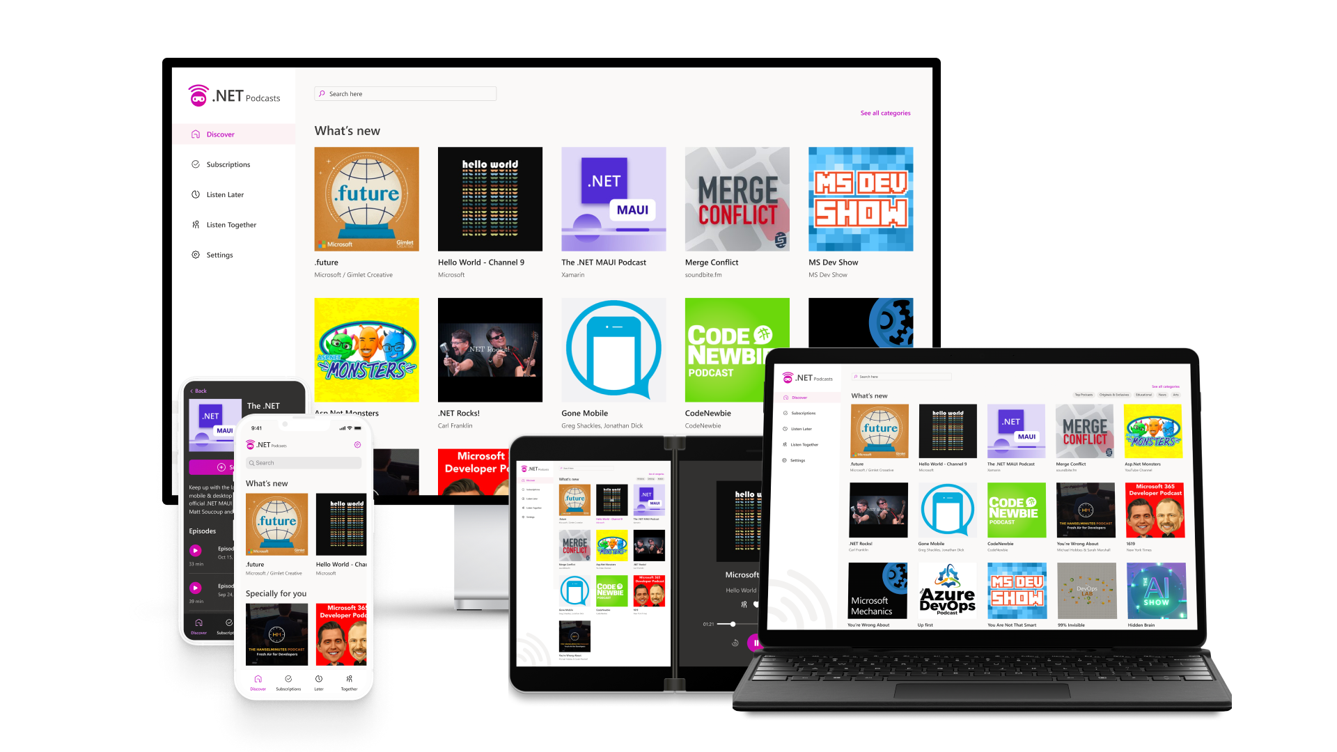
.NET Multi-platform App UI is the most productive way to develop native apps with a single codebase that perform great on any consumer device you might think of.
Sources: blog.google/products/android/android-12-beta/ ; www.imore.com/apple-earnings-call-transcripts-q1-2021 ;
Notes:
In order to reach all of these devices with beautiful app experiences, we built .NET MAUI to be the most productive way to develop native apps with a single codebase that perform great on any device. Instead of learning different stacks and languages for each device, you can use one language, one set of libraries, and one UI stack for all of them.
APIs are available directly from C# to access over 60 device platform features including things like isolated storage, sensors, geolocation, camera, and more. Use one programming language, one codebase, and one project system for all device targets with support for cross-platform resources including images, icons, splash screens, and more. .NET MAUI on Windows supports WinUI allowing these apps to use all the newest native features on supported versions of Windows 10 and 11.

Slide 11
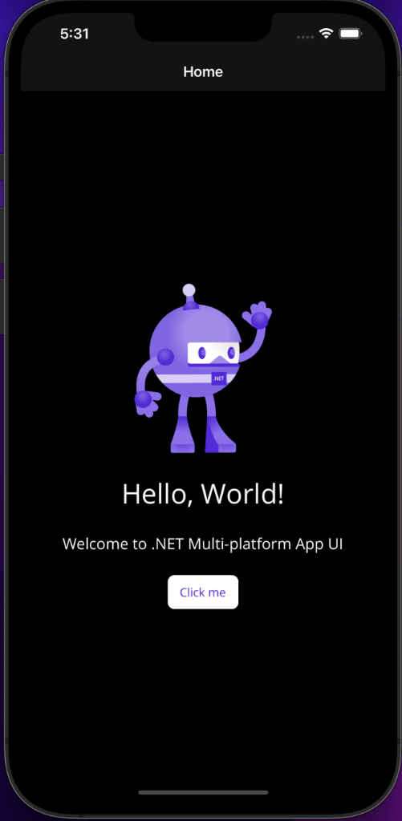
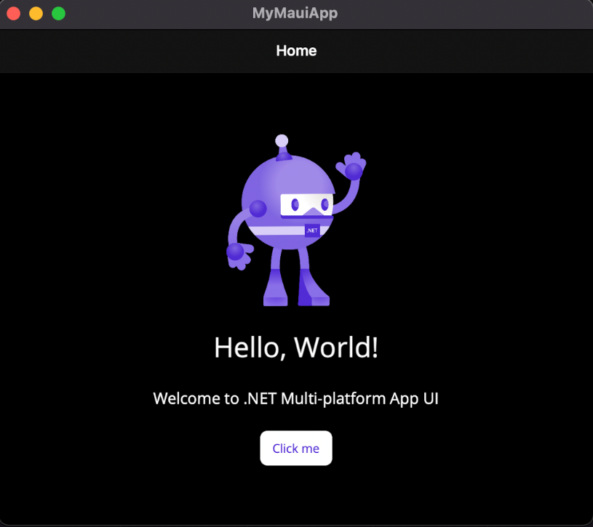
One codebase, single project, multi target
Notes:
[M]

Slide 12



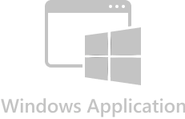
Native
android.widget
AndroidX libraries
Java/Kotlin APIs
UIKit
ARKit, AVKit, CarPlay, and dozens more
Obj-C/Swift APIs
Mac Catalyst
UIKit + AppKit
Dozens of frameworks
Obj-C/Swift APIs
Windows App SDK
WinUI 3
C++ APIs

Slide 13
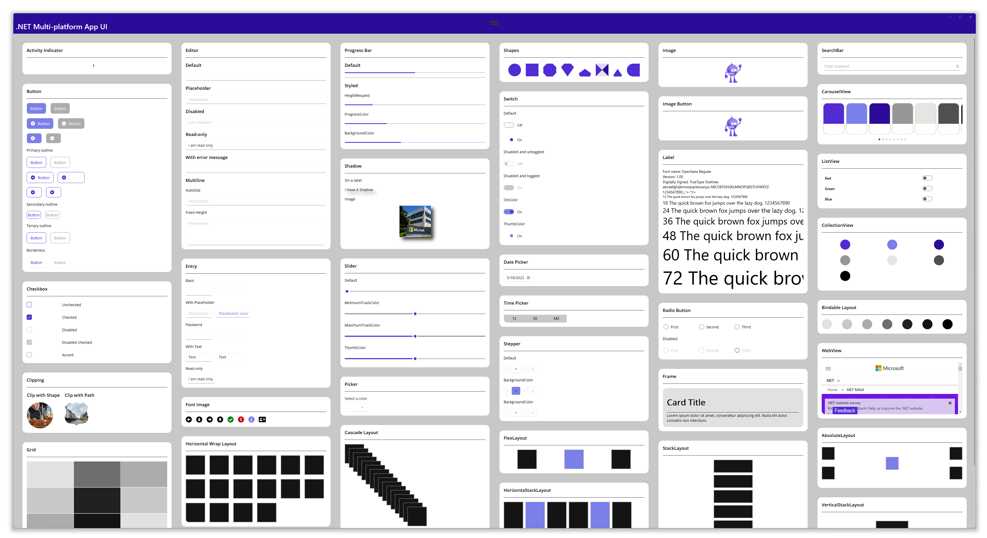
Over 50 Controls, Layouts and Views

Slide 14
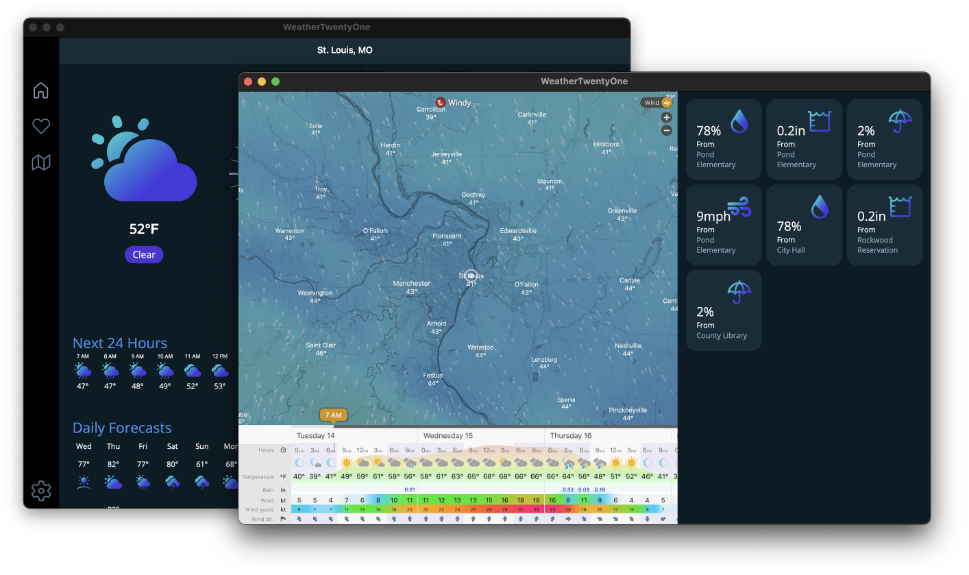
Multi-window

Slide 15
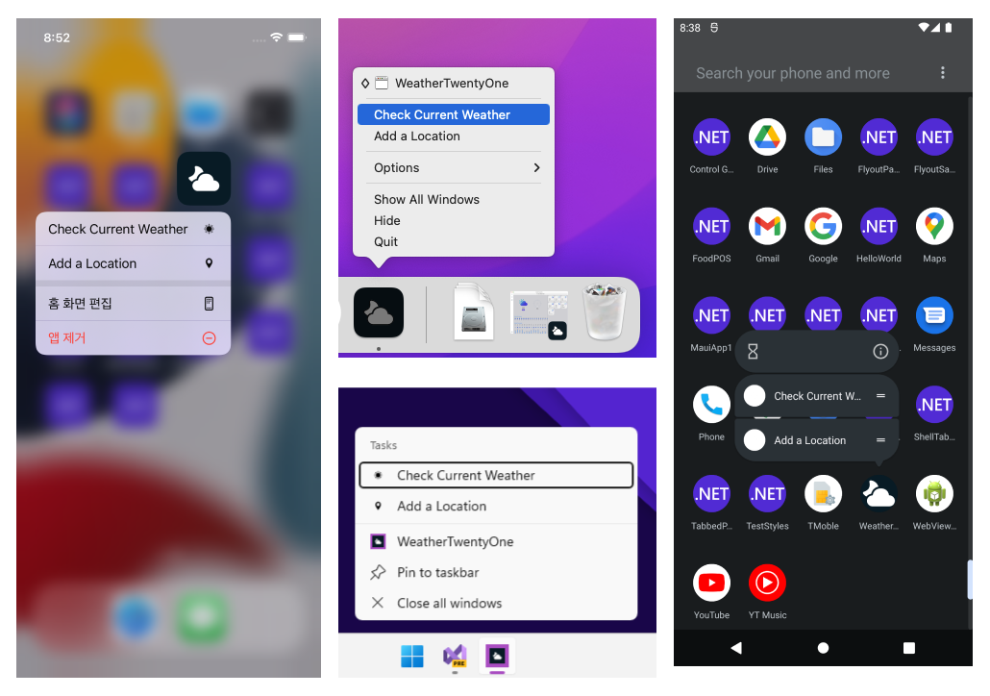
Beyond UI
Simple access to APIs
Access services and features of each platform
App actions
Clipboard
Device sensors
File system
Network
Notifications
+More

Slide 16

Modern Patterns
MVVM
Provide Values
View Bound to ViewModel
Model
ViewModel
View
Updates
Triggers Commands
MVU
ReactiveUI
Generated View
View
User Action
Model
Message
Reducer
New Model
Notes:
As you know Xamarin.Forms support MVVM (model-view-viewmodel) and RxUI (ReactiveUI) patterns. In addition to those, .NET MAUI will support MVU (model-view-update) and Blazor development patterns.
MVU This pattern provides a unified way to build cross-platform native front ends from a single code base. It also allows us to write UI code and logic in C# as shown below.
MVVM(Model View ViewModel) MVVM is the default built in architecture design pattern in the xamarin.Forms framework. The UI in MVVM is Mutable. Which make managing the state difficult and cause many issues. It consists of three parts. • Model- The definition of data • View- The User Interface for user to interact with the app • ViewModel- The ViewModel stays in between the View and Model. It have all the business logic and presentation logic. The MVVM enable to keep the UI code, Logic and Data separate. Thus it help in easy maintenance. You can learn more about MVVM at https://docs.microsoft.com/en-us/xamarin/xamarin-forms/enterprise-application-patterns/mvvm
ReactiveUI ReactiveUI is a framework which enables use of Reactive Programming over MVVM design pattern. Reactive Programming is done using Reactive Extensions. The Reactive Extensions (Rx) is a library for composing asynchronous and event-based programs using observable sequences and LINQ-style query operators. ReactiveUI make mutable state managable. DynamicData is part of ReactiveUI which makes managing any kind of data very efficient. The definition given at reactiveui.net is “An advanced, composable, functional reactive model-view-viewmodel framework for all .NET platforms!”. The Reactive code is concise and testable. You can learn about it at https://www.reactiveui.net/
MVU( Model View Update) MVU is a Functional Reactive Programming, architecture design pattern. In MVU UI is immutable. So you have to rebuild your UI, every time you wanted to update a property. Immutability is the property of Funtional Programming. C# does support Functional programming paradigm. C# is taking it further with C# 9 and dot net 5 release in November 2020. In this setup the UI and business login is written in same language e.g C#. The flow of data is unidirectional. It is Good fit for hot reload of the application. You don’t need to learn XAML for developing UI instead develop complete application in one language.
MVU This pattern provides a unified way to build cross-platform native front ends from a single code base. It also allows us to write UI code and logic in C# as shown below.

Slide 17
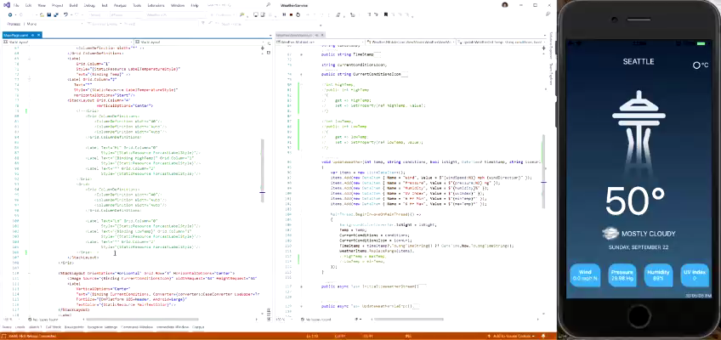
.NET MAUI Hot Restart
Fast rebuild and redeploy of your application
Debug on your iPhone directly from your PC
Works great with Hot Reload!

Slide 18
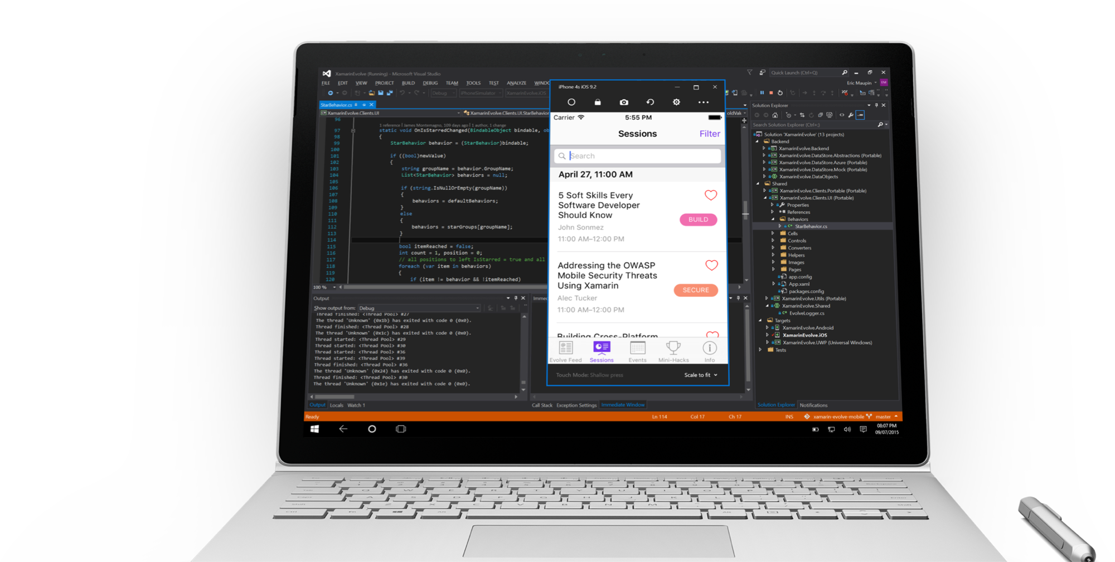
Visual Studio iOS Simulator Remoting
Multi-Touch Enabled
Pressure Sensitive
Super Fast
Rotate, screenshots,
location changes
Never leave VS

Slide 19
.NET MAUI in .NET 8
Performance
Quality
Ecosystem
Hybrid Apps
Developer Experience

Slide 20
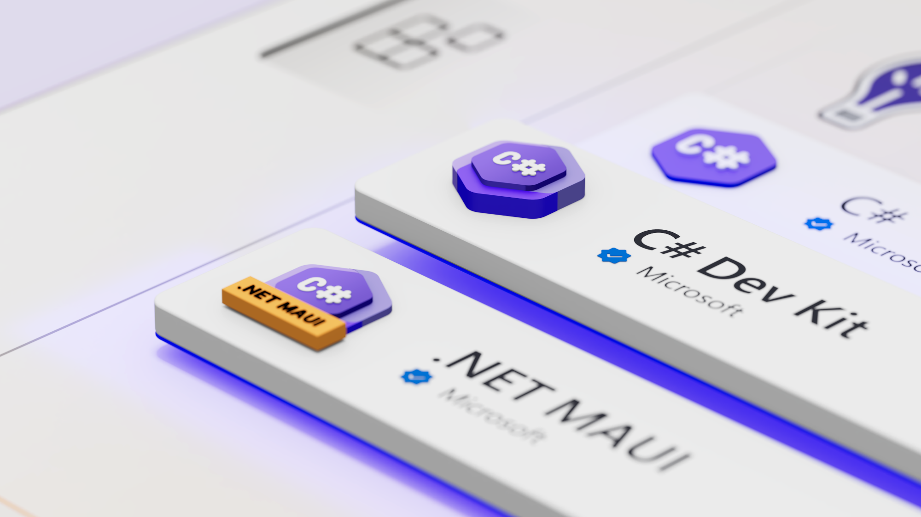
aka.ms/csdevkit
aka.ms/mauidevkit

Slide 21

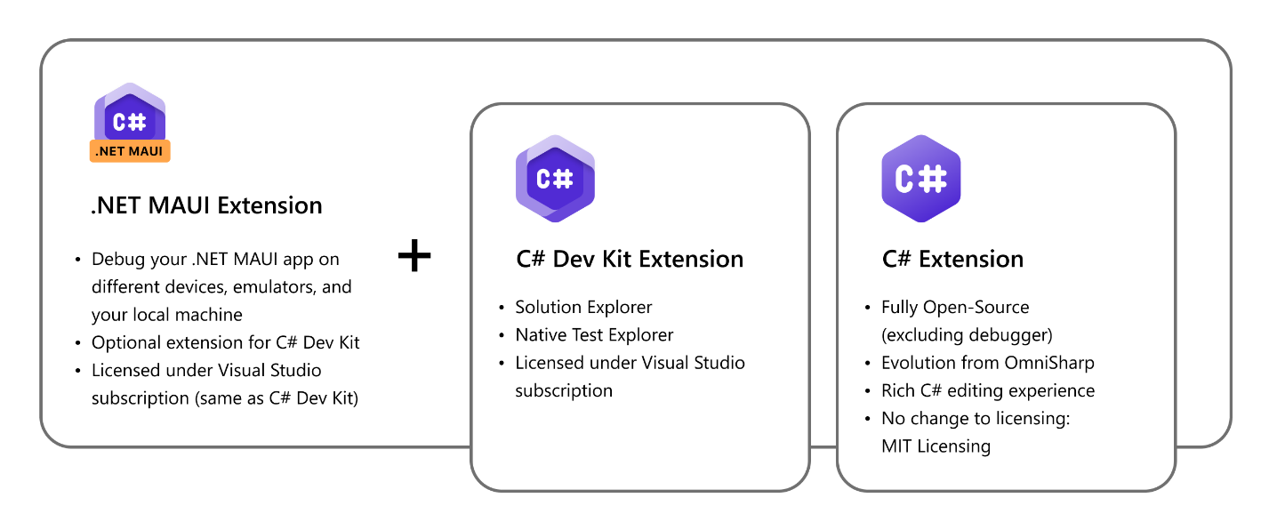
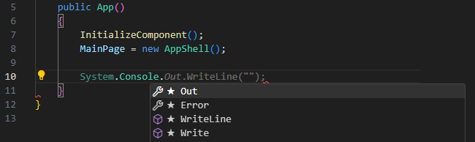
Visual Studio Code extension
Along with the IntelliCode for C# Dev Kit extension, you get AI-assisted features such as whole-line completions and starred suggestions as you type.
Debug to any target !
Notes:
which, paired with C# Dev Kit, gives you the tools you need to develop your cross-platform .NET mobile and desktop apps with VS Code on Windows, macOS, and Linux. which, paired with C# Dev Kit, gives you the tools you need to deve
Code editing powered by Roslyn
C# editing is backed by the newly updated open-source C# Extension, giving you powerful IntelliSense code-completion. Along with the IntelliCode for C# Dev Kit extension, you get AI-assisted features such as whole-line completions and starred suggestions as you type.
When editing your XAML, you get lightweight syntax highlighting and autocomplete that learns from your habits as you type.
Debug to any target
The .NET MAUI extension makes it easy to debug and deploy your app to your different target devices (Android, iOS, macOS and Windows). Just pick your device through the “Language Status” popup by hovering over the curly braces { }, selecting “Debug Target”, then starting a debug session (F5).
In this preview, we’ve added the following device targets:
On Windows, you can debug to your local Windows machine, Android emulators, and Android devices
On macOS, you can debug locally on your Mac, on iOS simulators or devices, and Android emulators or devices
On Linux, you can debug to Android emulators and devices
lop your cross-platform .NET mobile and desktop apps with VS Code on Windows, macOS, and Linux.

Slide 22
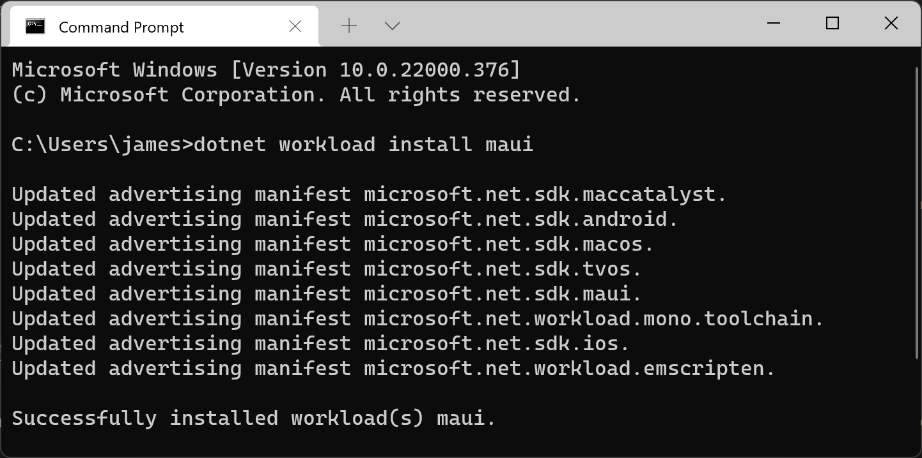

.NET CLI
dotnet new maui -n HelloMaui
mkdir HelloMaui
cd HelloMaui
dotnet newmaui
dotnet build -t:Run -f net8.0 -android

Slide 23
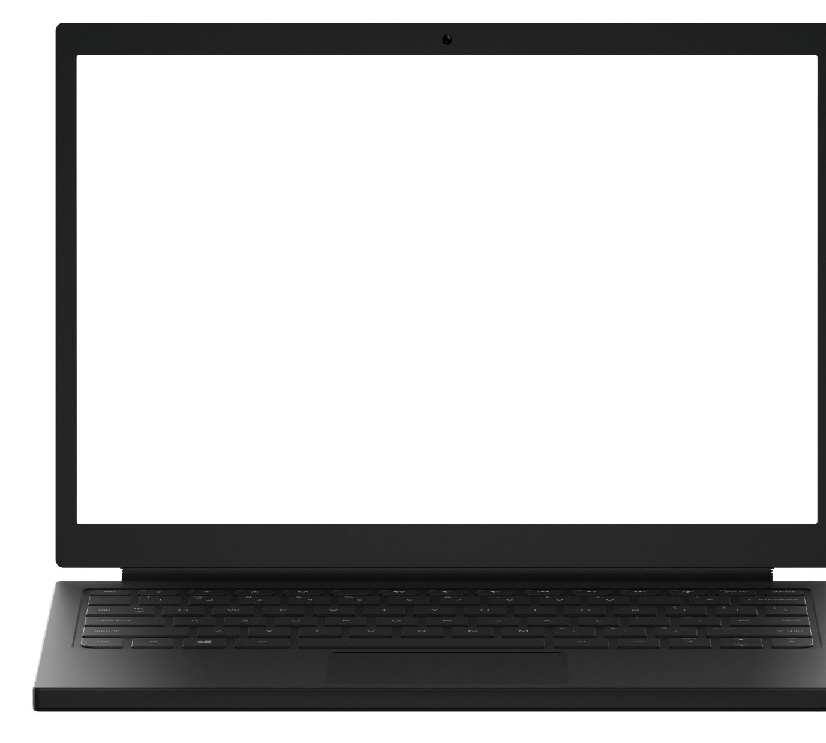
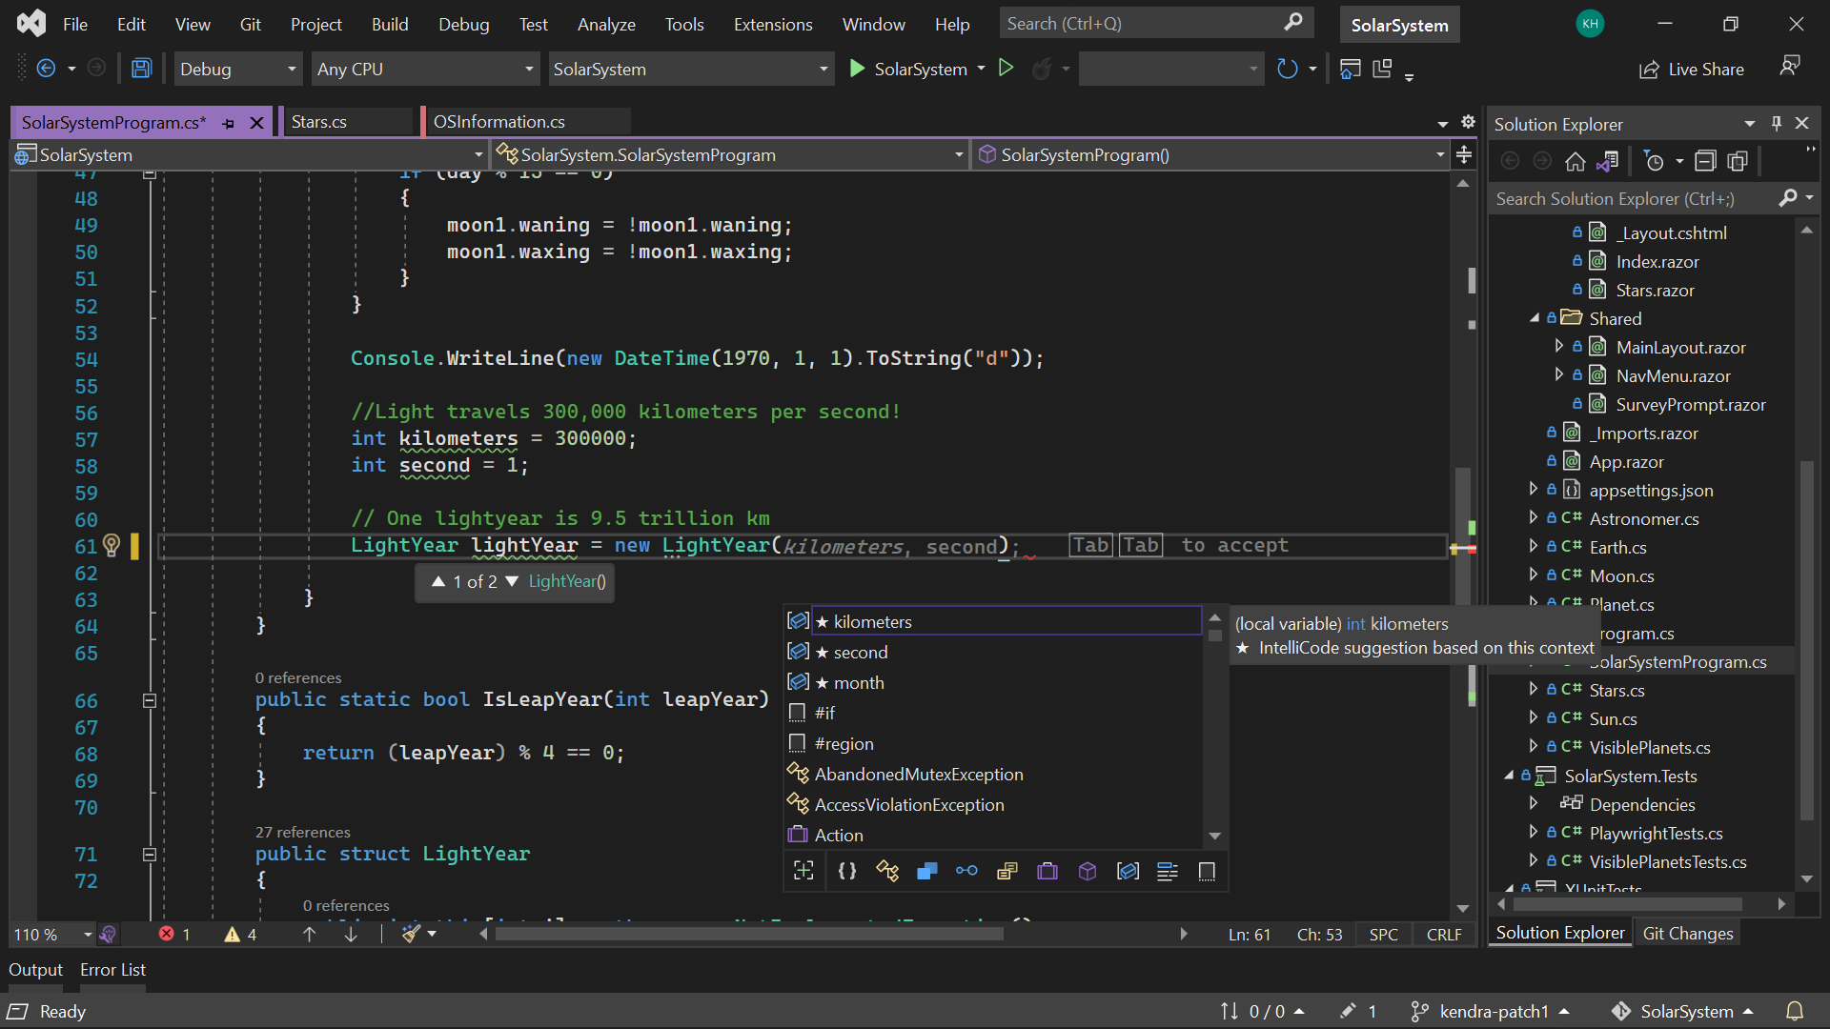
Visual Studio 2022
Modern development
Build innovative, modern apps using .NET 6, GitHub and Azure with integrated tooling
Personal and team productivity
Live Share, Hot reload everywhere, Web live preview, IntelliCode, enhanced debugging and testing tools
Scale to projects of any size
An optimized, modern UI built on 64-bit architecture to support the largest, most complex codebases and workflows
VisualStudio.com/download

Slide 24
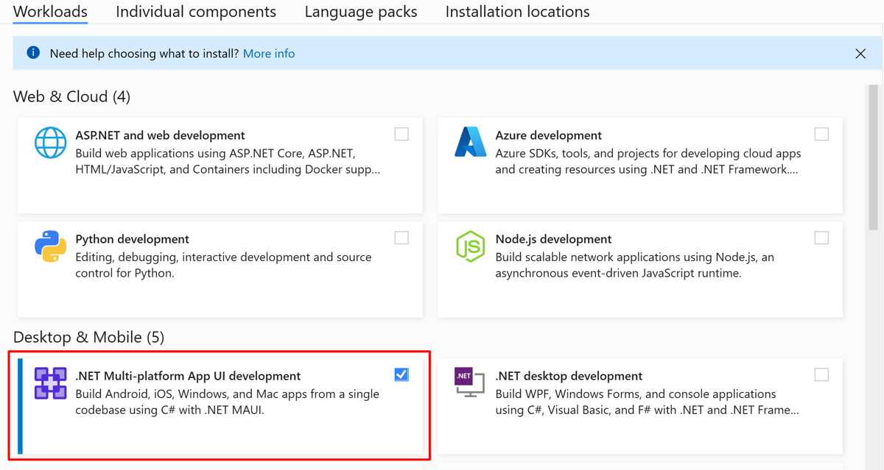
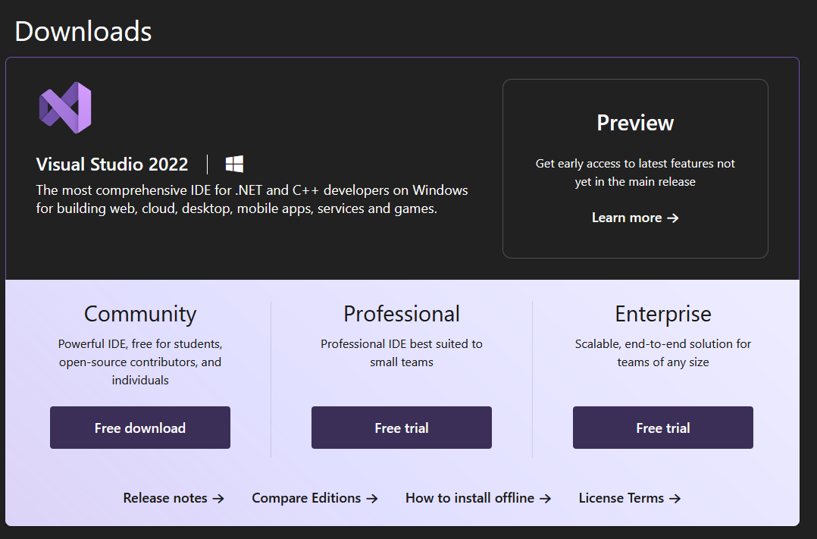
Visual Studio

Slide 25
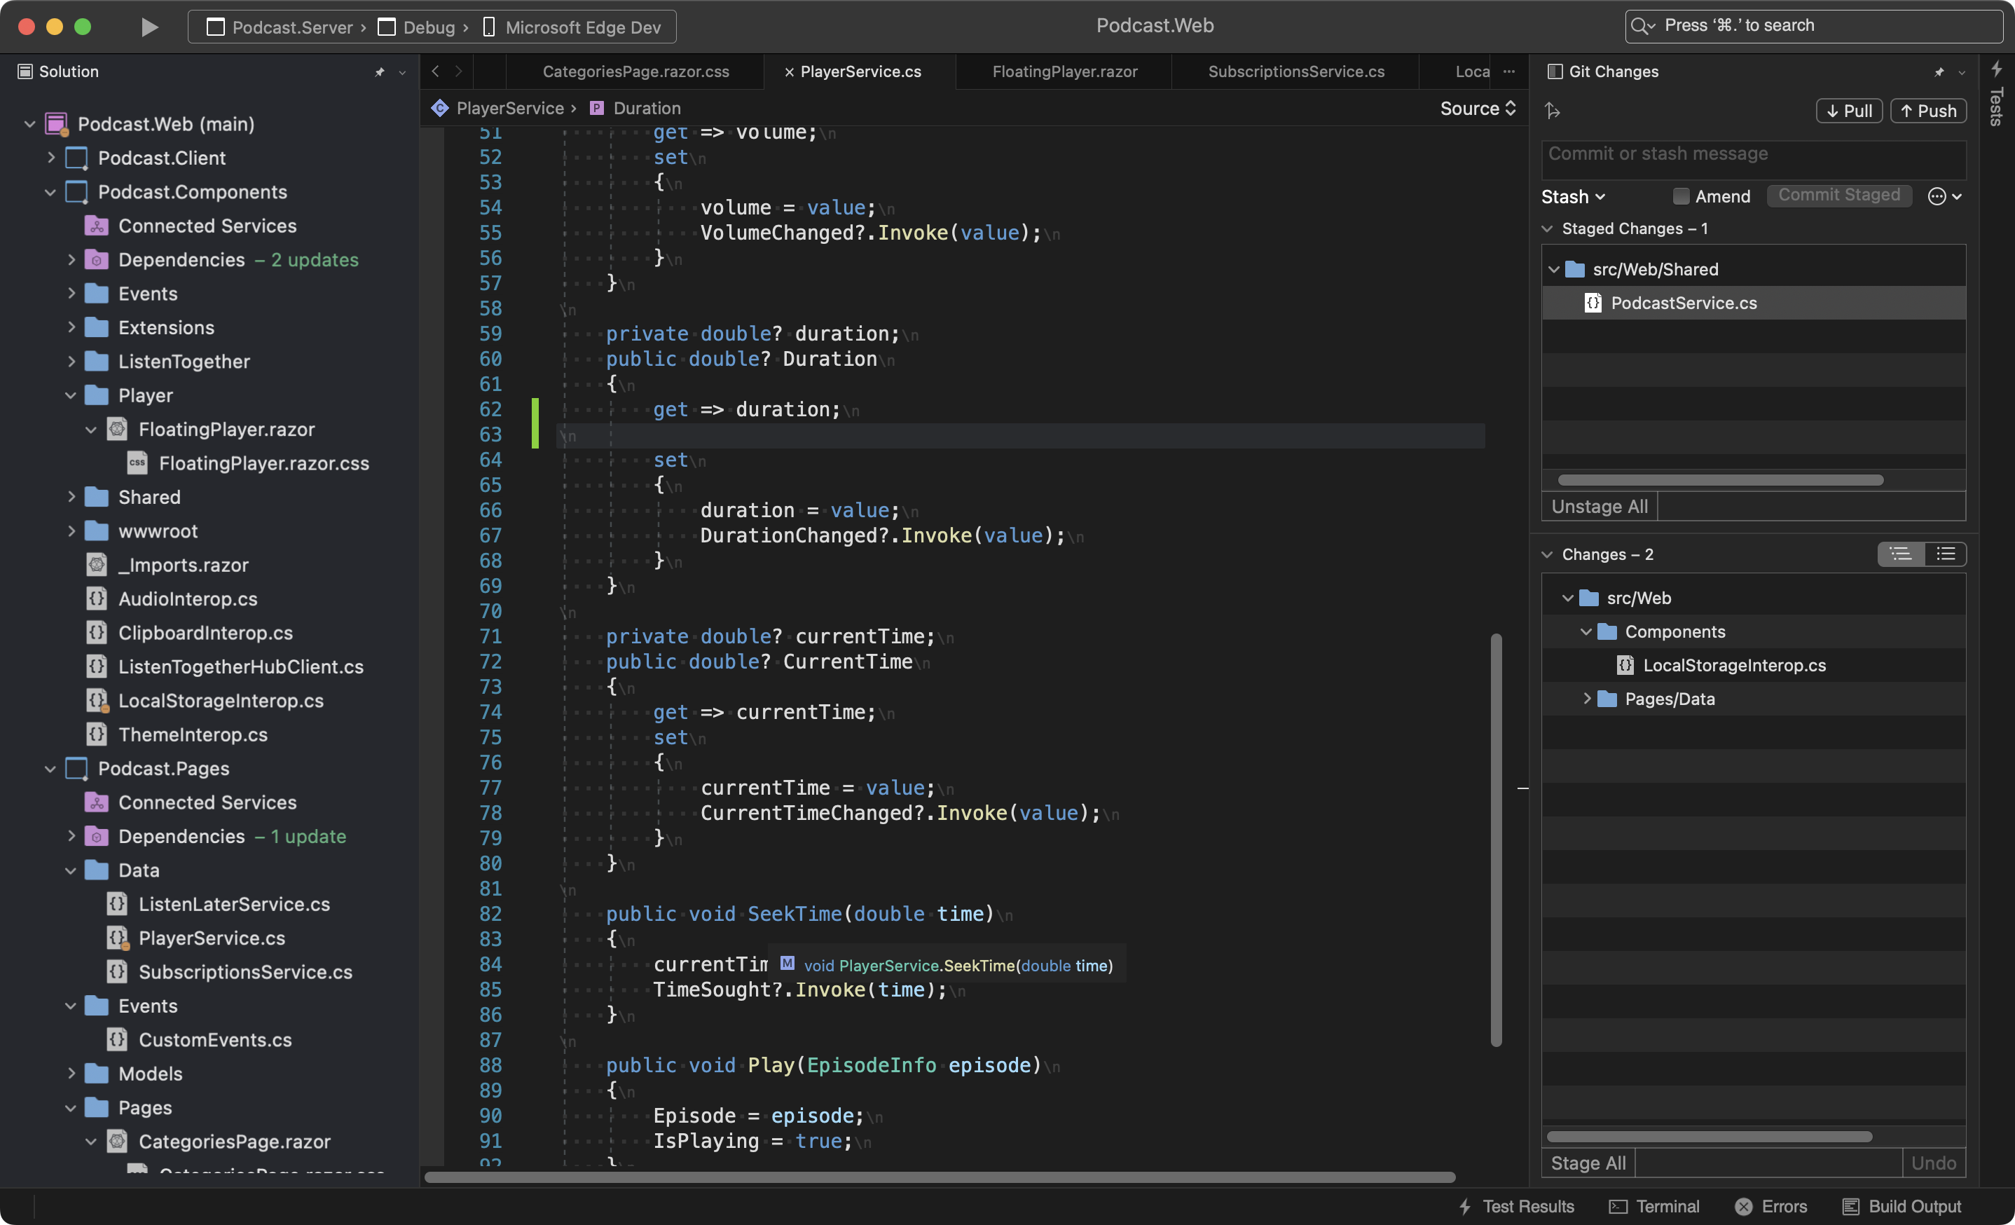
Visual Studio 2022 for Mac
Fast and Fluid
Focused on performance with over 100 user reported issues fixed; running on .NET 6 and with native support for Apple’s M1 processor
Modern macOS UI
A rewritten UI, using native macOS Cocoa APIs. With native theming, full screen support, and macOS accessibility tooling.
Support for .NET 6
Build for the web, cloud, and (soon) mobile, using .NET 6.

Slide 26


Demo

Slide 27
Performance Improvements in .NET MAuI

Slide 28
.NET MAUI: Fundamentals & Quality
.NET 8 timeframe:
Merged 1,618 pull requests that closed 689 total issues
Performance goals:
Aim to be slightly better than .NET 7
.NET 8 includes some interesting performance improvements.
aka.ms/mauiperf8

Slide 31
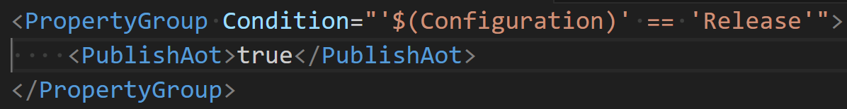
NativeAOT on iOS, Experimental Support
NativeAOT is not Mono -- basically a new runtime
NativeAOT apps have faster startup time and smaller memory footprints
Future/.NET 9 plans
Improve “trimmability” of .NET MAUI: https://github.com/dotnet/maui/issues/18658
Experiment how NativeAOT might work on Android

Slide 32
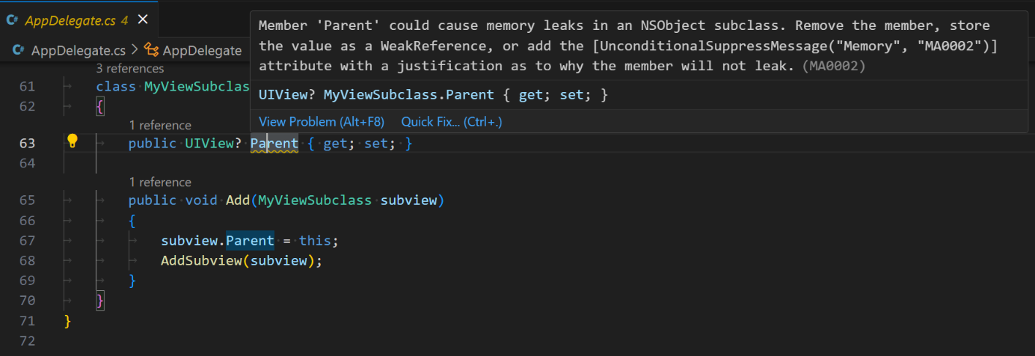
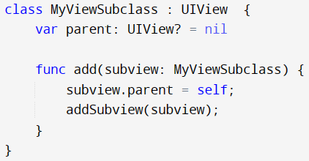
Memory Leaks on Apple Platforms
https://aka.ms/maui-memory-leaks
Roslyn analyzer for iOS circular references
Take for example the following Swift code:
Parent -> Child, and Child -> Parent
The same situation can occur in C#

Slide 33
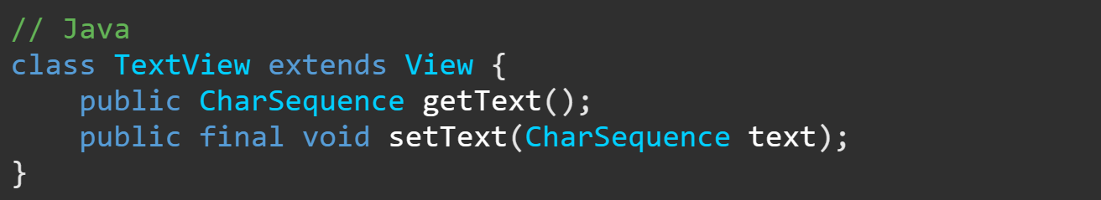
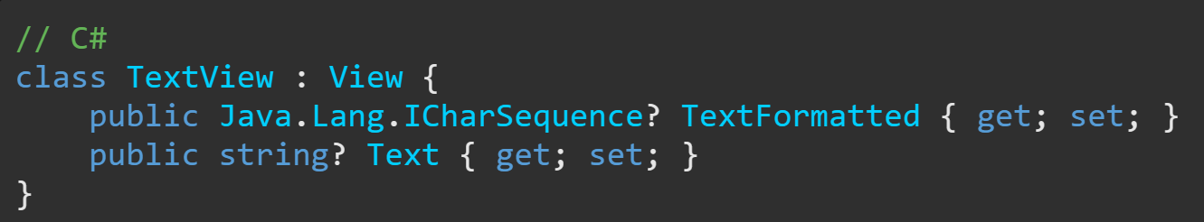
Android: Improvements in Java interop

Slide 34
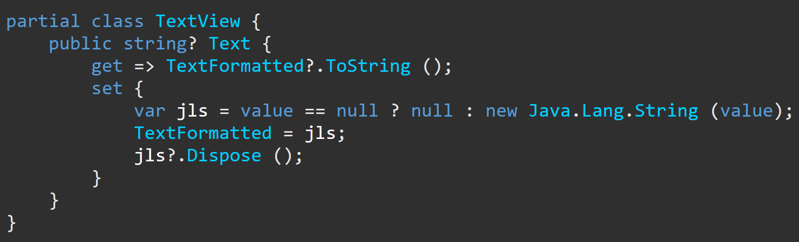
Android: Improvements in Java interop

Slide 35
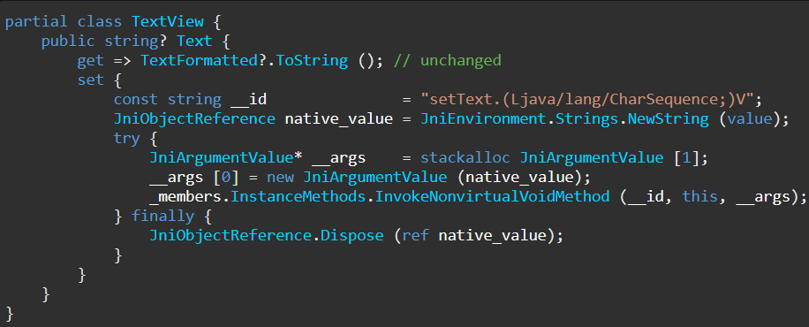
Android: Improvements in Java interop

Slide 36

Resources
.NET 8 Performance Improvements in .NET MAUI aka.ms/mauiperf8
Wiki page about profiling .NET MAUI aka.ms/profile-maui
Wiki page about Memory Leaks aka.ms/maui-memory-leaks

Slide 37
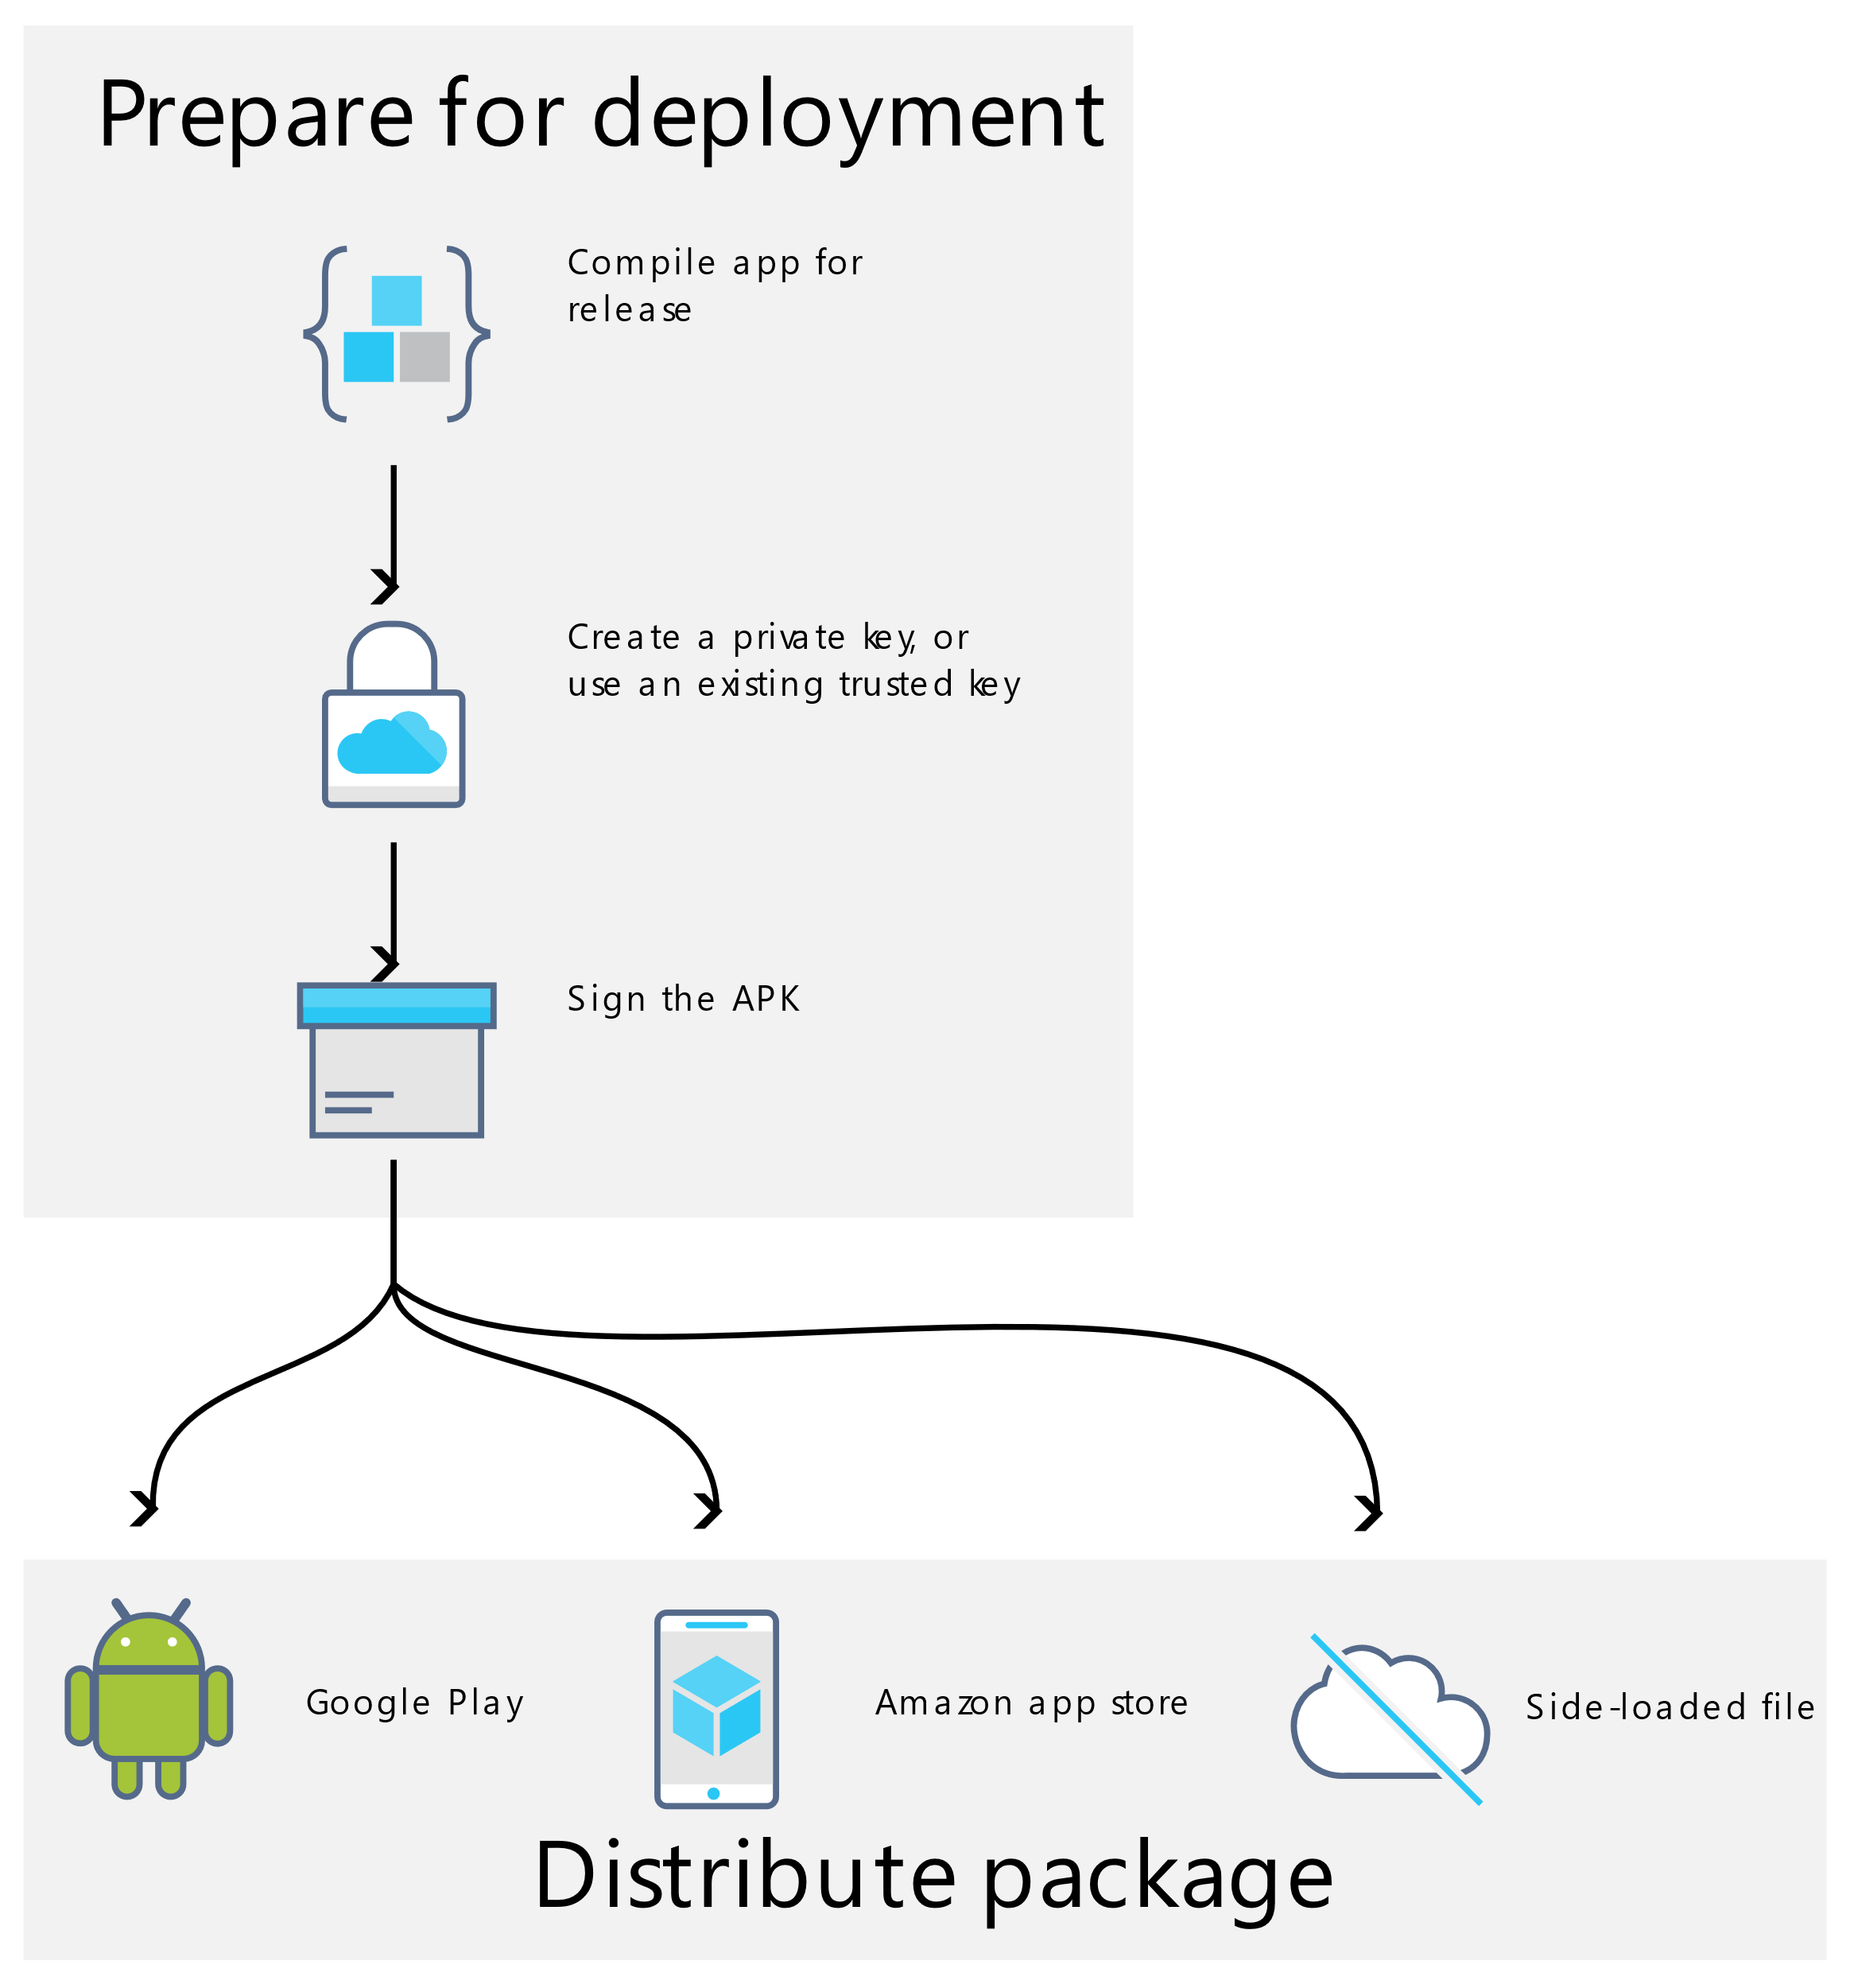

Ready for the stores

Slide 38

Questions Time
@_Codrina_

Slide 39
Thank you!
Add me on LinkedIn:
Follow me on X(twitter):
in/codrinamerigo/
@_Codrina_
This presentation is for educational purposes only.
Opinions or points of view expressed in this presentation represent the view of the speaker.
All trademarks, logos and brand names are the property of their respective owners.

Slide 41
Ready for the stores

